Slide 1
Predict LA resident health using crime data
Yiqiao Li

Slide 2
Raw data
Column Name
DR Number
Date Reported
Date Occurred
Time Occurred
Area ID
Area Name
Reporting District
Crime Code
Crime Code Description
MO Codes
Victim Age
Victim Sex
Victim Descent
Premise Code
Premise Description
Weapon Used Code
Weapon Description
Status Code
Status Description
Crime Code 1
Crime Code 2
Crime Code 3
Crime Code 4
Address
Cross Street
Location
Crime data
2010 - present
194889 instances
26 attributes
Census tract data
Physical health not good for >=14 days
Year - 2014
1005 instances
24 features
Census boundaries data - 2010
GeoJSON

Slide 3
Data cleaning
STRONG-ARM (HANDS, FIST, FEET OR BODILY FORCE) 40488UNKNOWN WEAPON/OTHER WEAPON 5258VERBAL THREAT 5198HAND GUN 2887KNIFE WITH BLADE 6INCHES OR LESS 1006SEMI-AUTOMATIC PISTOL 1002OTHER KNIFE 885UNKNOWN FIREARM 720VEHICLE 667BOTTLE 450STICK 432REVOLVER 426ROCK/THROWN OBJECT 399FOLDING KNIFE 372CLUB/BAT 371BLUNT INSTRUMENT 355KITCHEN KNIFE 345
BATTERY - SIMPLE ASSAULT 18405THEFT PLAIN - PETTY ($950 & UNDER) 15753BURGLARY 13879VEHICLE - STOLEN 13672BURGLARY FROM VEHICLE 13096THEFT OF IDENTITY 12916INTIMATE PARTNER - SIMPLE ASSAULT 11582VANDALISM - FELONY ($400 & OVER, ALL CHURCH VANDALISMS) 0114 9672

Slide 4
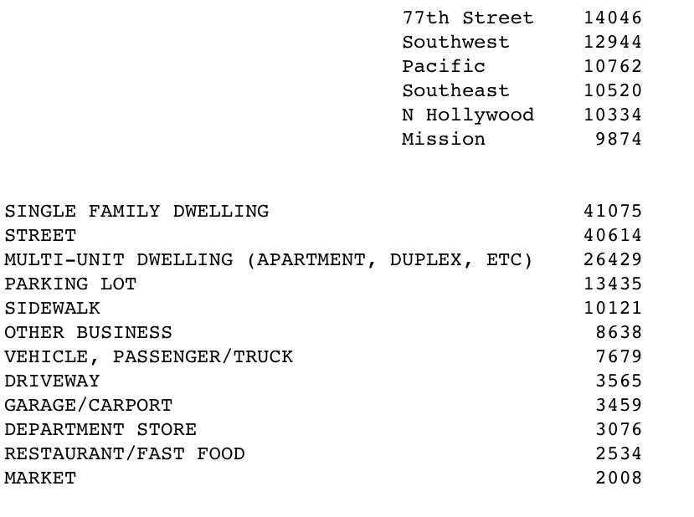
Crime Code Description

Slide 5
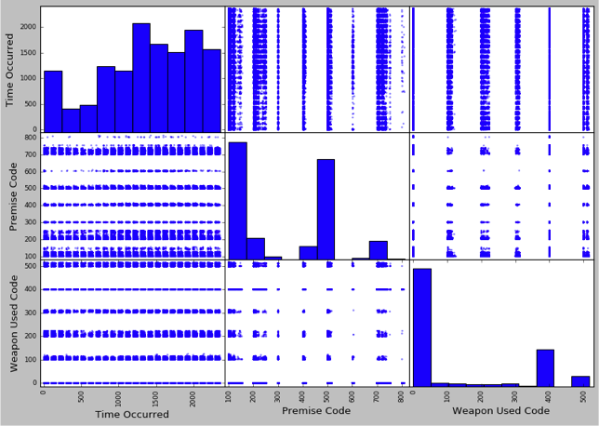
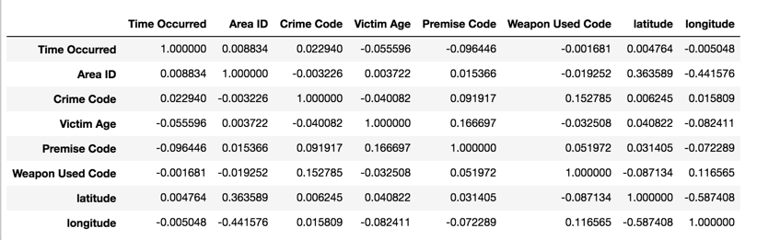
Need preprocessing
standard correlation coefficient
scatter_matrix

Slide 6
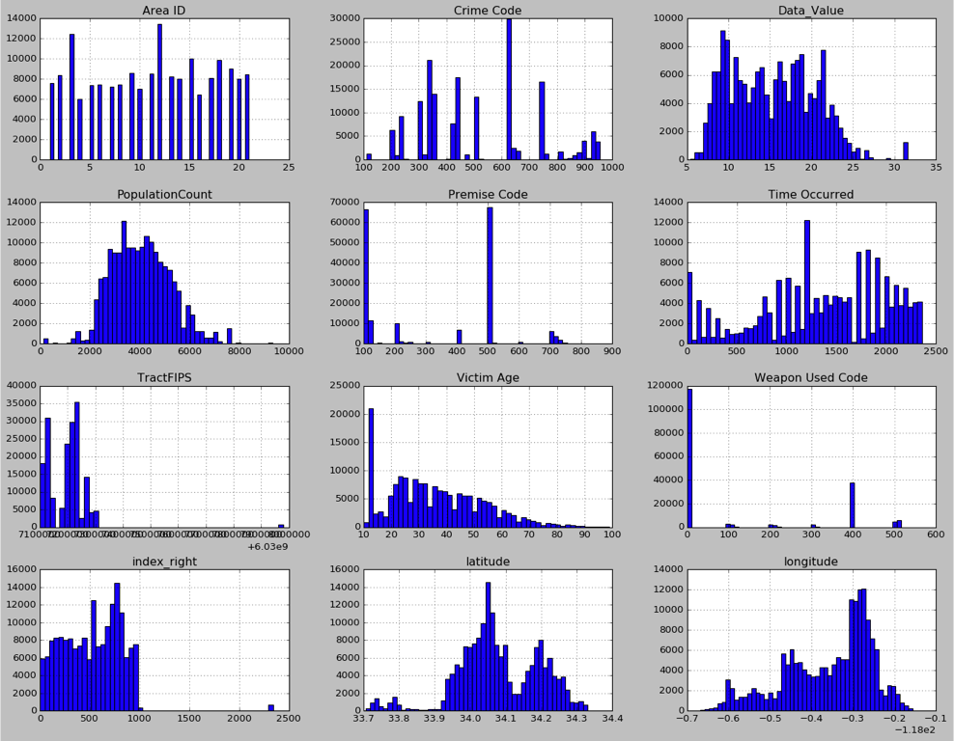

Slide 7
Preprocessing
Three-way join
Imputer(strategy= ? )
Median
The most dominant category
One-hot encoding
Sparse_matrix
Use Geocode to guess latitude and longitude
Feature Scaling

Slide 8
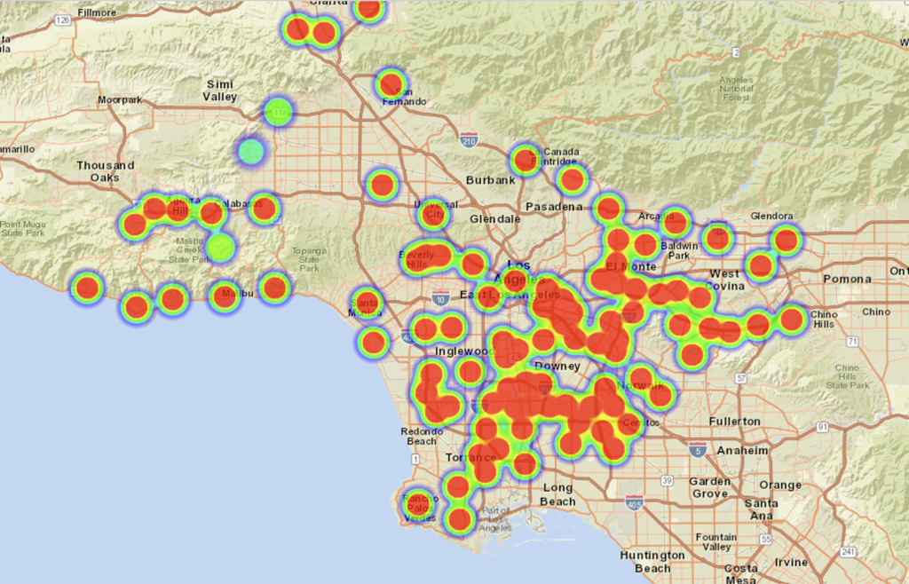

Slide 9
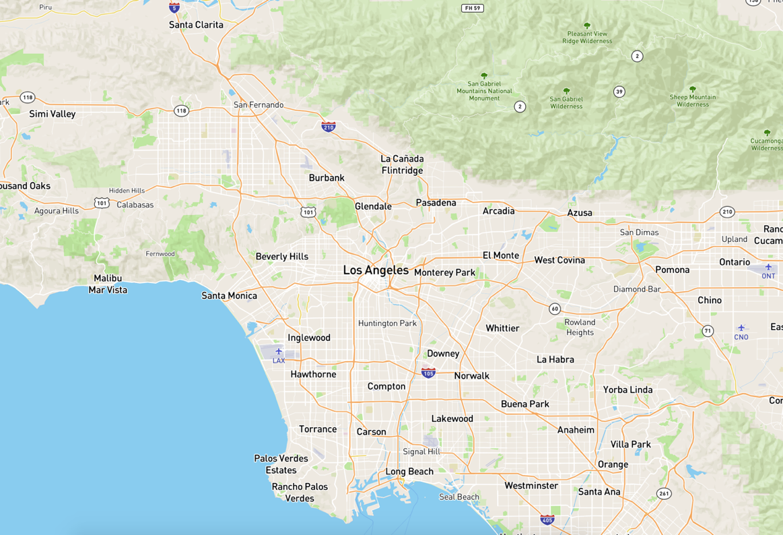

Slide 10
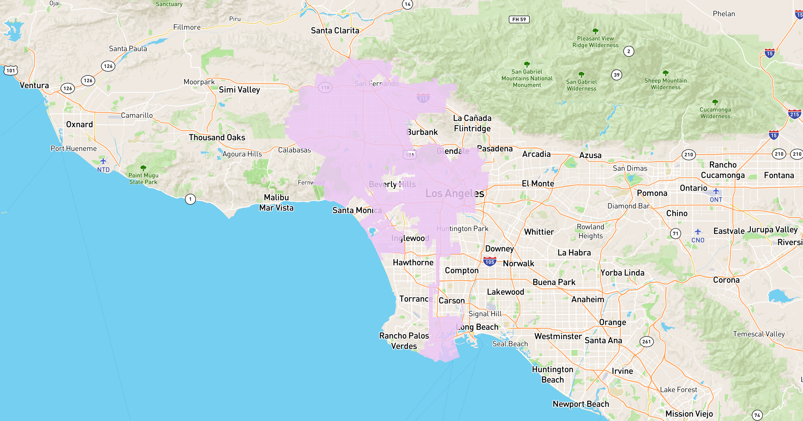

Slide 11
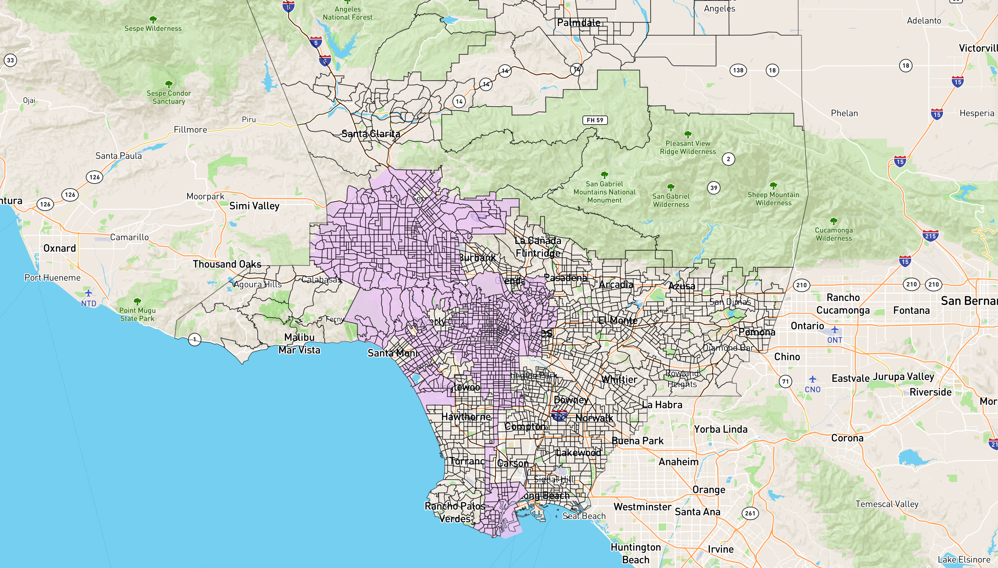

Slide 12
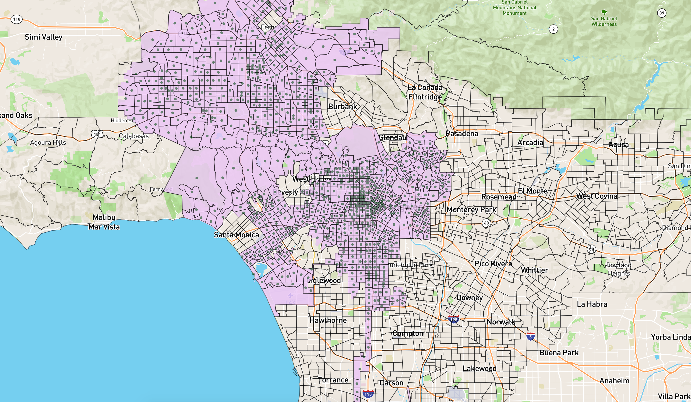

Slide 13
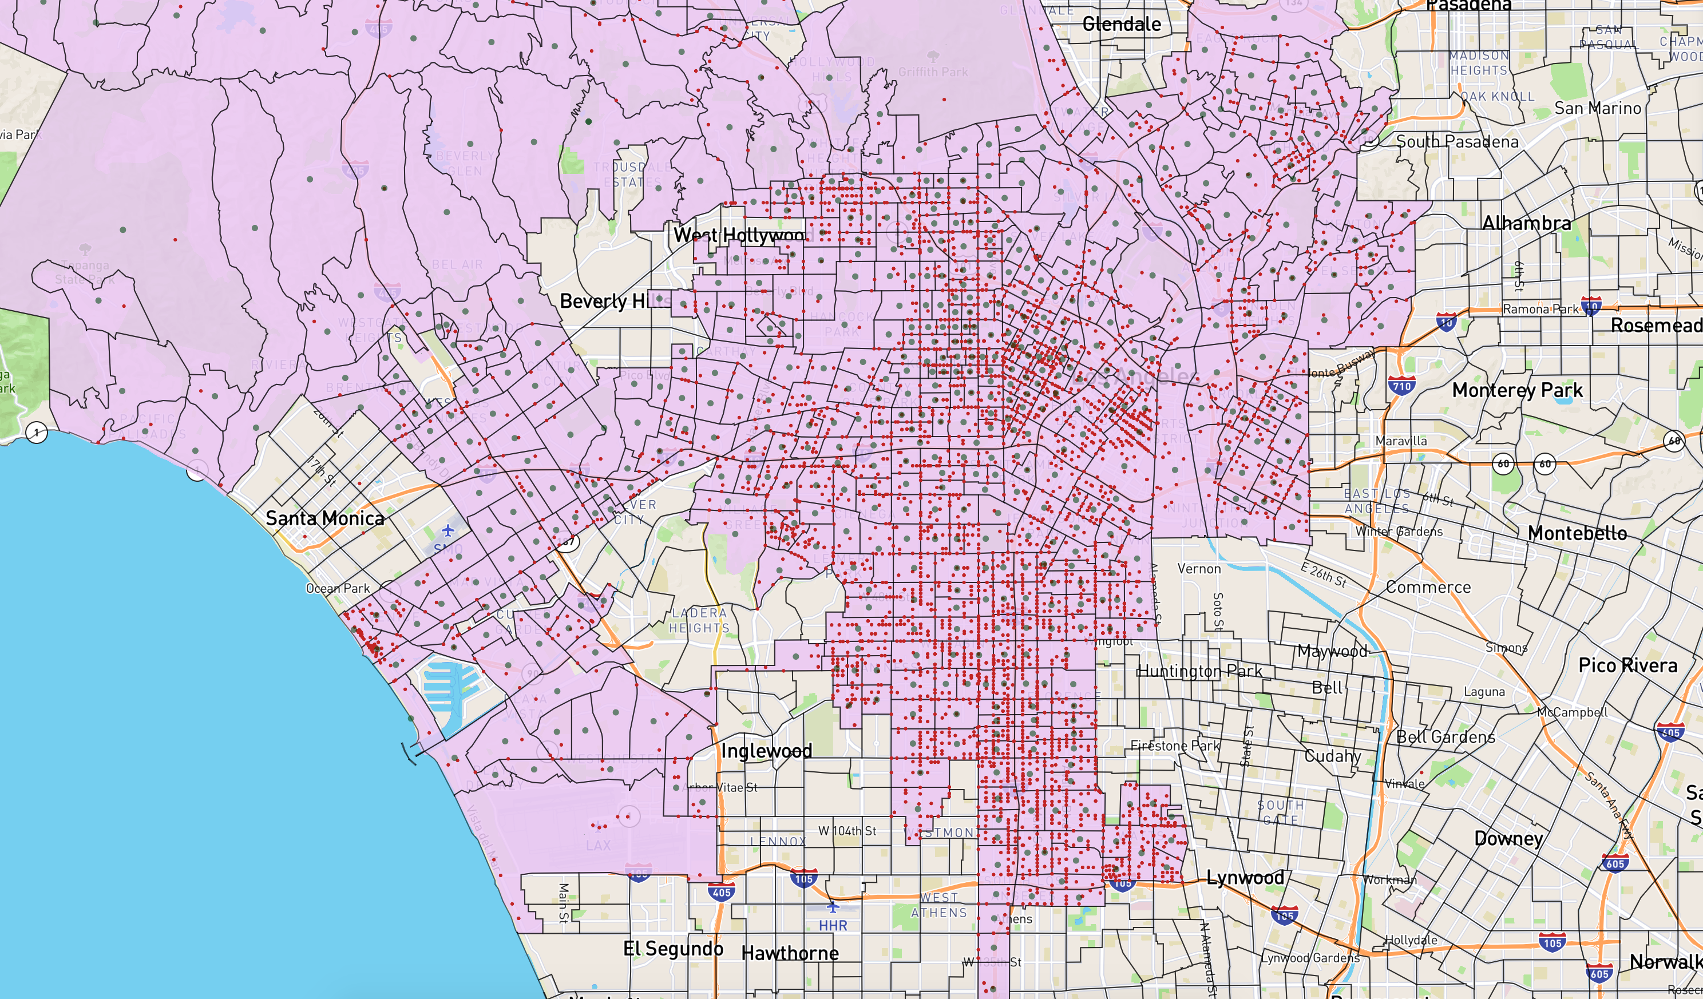

Slide 14
Conclusion
Health condition of areas of census tract can be predicted.
Crimes in LA is completely unrelated to health condition of areas.
Before :
Linear regression: 42.7%
SVR: 41.7%
random forest regression: 47.3%
After:
Linear regression: 59.1%
SVR: 57.2%
random forest regression: 68.4%

